Slide 1
Severe Acute Malnutrition
Dr. Ali Hassen , MD

Slide 2
Outline
Introduction
Epidemiology
Nutritional assessment
Classification of undernutrition
Patho-physiologic and adaptive changes
Diagnosis and clinical features
Management principles
Dx & management of Complications

Slide 3
Objectives
To understand classification of malnutrition
To understand magnitude of malnutrition nationally
To know the different body system affected by sever acute malnutrition
To understand the pathophysiology
To know complications of SAM
To understand management principle

Slide 4
Introduction
Food insecurity indicates inadequate access to food for whatever reason.
Hunger is the immediate physiologic manifestation of inadequate food intake.
Undernutrition describes the biochemical &/or physical consequences of long-term inadequate intake.
Food insecurity, hunger, and under-nutrition are viewed as a continuum, with food insecurity resulting in hunger, and ultimately, if sufficiently severe and/or of sufficient duration, in undernutrition.

Slide 5
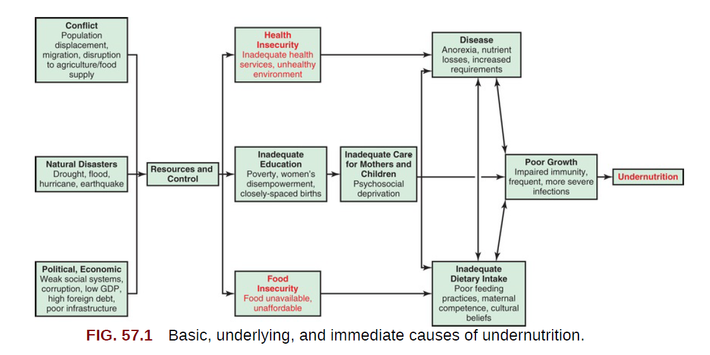

Slide 6
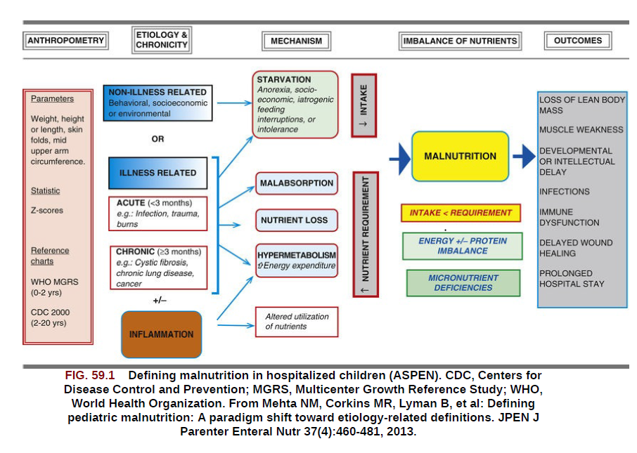
Etiology

Slide 7
Cont….
  The WHO defines malnutrition as the cellular imbalance between the supply of nutrients and energy and the body’s demand for them to ensure growth, maintenance and specific functions.
  PEM – a condition that results when the body’s needs for protein and energy fuels are not satisfied by diet also accompanied by deficiency of several micronutrients.
Notes:
Low anthropometry is associated with high mortality

Slide 8
Epidemiology
In 2017, FAO estimated that about 821 million people, or 10.9% of the world's population, were undernourished, 98% of whom were in developing countries..
Wasting (weight-for-height < −2 SD) affects 7% of children <5 year, with minimal change in prevalence over the past 2 decades.
The global prevalence of stunting has declined from 33% in 2000 to 22% in 2017, with the greatest reductions occurring in Asia.
Stunting prevalence is highest in the African region (30%).
Infections can adversely affect nutritional status, and young children can quickly enter a cycle of repeated infections and ever-worsening malnutrition.
For girls, the cycle of undernutrition is passed on to the next generation when undernourished women give birth to LBW babies.

Slide 9
Ethiopian Burden
In Ethiopia according to EDMHS 2019:
  37 % of children under age five are stunted (18% are severely stunted)
  Overall, 7% of Ethiopian children are wasted, and 1% are severely wasted.
  21 % of children under age five are underweight.
  The proportion of underweight children is highest from 24-35 months (34 percent), which is the usual time for weaning.
  Somali and Afar having the highest percentages of children who are wasted, 21% and 14%, respectively.
  Children with severe acute malnutrition (SAM) have a nine-fold risk of mortality compared to well-nourished children hence the need for appropriate management

Slide 10
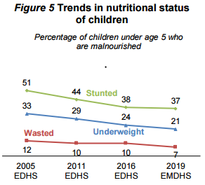

Slide 11
Nutritional assessment
Medical and dietary history
Anthropometric evaluation and physical examination
Laboratory measurements

Slide 12
Medical and dietary history
Medical history
  Review of acute and chronic illnesses
  History of preexisting nutrient deficiencies
  Social history (poverty, domestic violence, parental employment, parental marital status, and parental substance abuse)
  Illnesses prior to or after development of malnutrition
Dietary history
  Quantity and quality of current intake.
  Infant and young child feeding practices.
    history of breast feeding pattern
    formula preparation
    volume consumed
    feeding techniques

Slide 13
Anthropometric Evaluation
Selection of measurements
  Age
  Weight
  Height/L
    Length : supine for children aged less than 2 years
    Height : standing for children aged 2 years or more
  MUAC:-6 months-59 months.
  BMI:-Above 5 years.

Slide 14
Weight Measurement
  There are many types of scales currently in use.
  • Uni-scale (tared weighing)
  • Salter Scale (hanging scale)
  • Beam Scale
  For children below 6 years. A Salter spring balance with the scale measuring up to a maximum of 25 kg with calibration of 100 g.
  For children aged 6-10 years, a beam scale on which the child is made to stand..
  Both age groups readings are taken to the nearest 100 g.

Slide 17
Height/Length measurement
Length is measured lying down on the back (recumbent).
Height is measured standing upright.
• For children under 2 years (or is less than 87cm or if the age is not available) measure the length.
• For children 2 years or older (or is 87cm or more if the age is unknown) and able to stand measure the height.
Note: Length is usually greater than standing height by 0.7cm. If the child is 87 cm or more, but cannot be measured standing, subtract 0.7 cm from the supine length

Slide 18
Cont…..
  To measure length:
  Infant is laid down on the board
  Head is positioned firmly against the fixed headboard with eyes looking vertically
  Knees are extended by firm pressure
  Feet are flexed at right angles to the lower legs
  The upright sliding foot-piece is moved to obtain firm contact with the heels and the length read to the nearest 0.1 cm

Slide 19
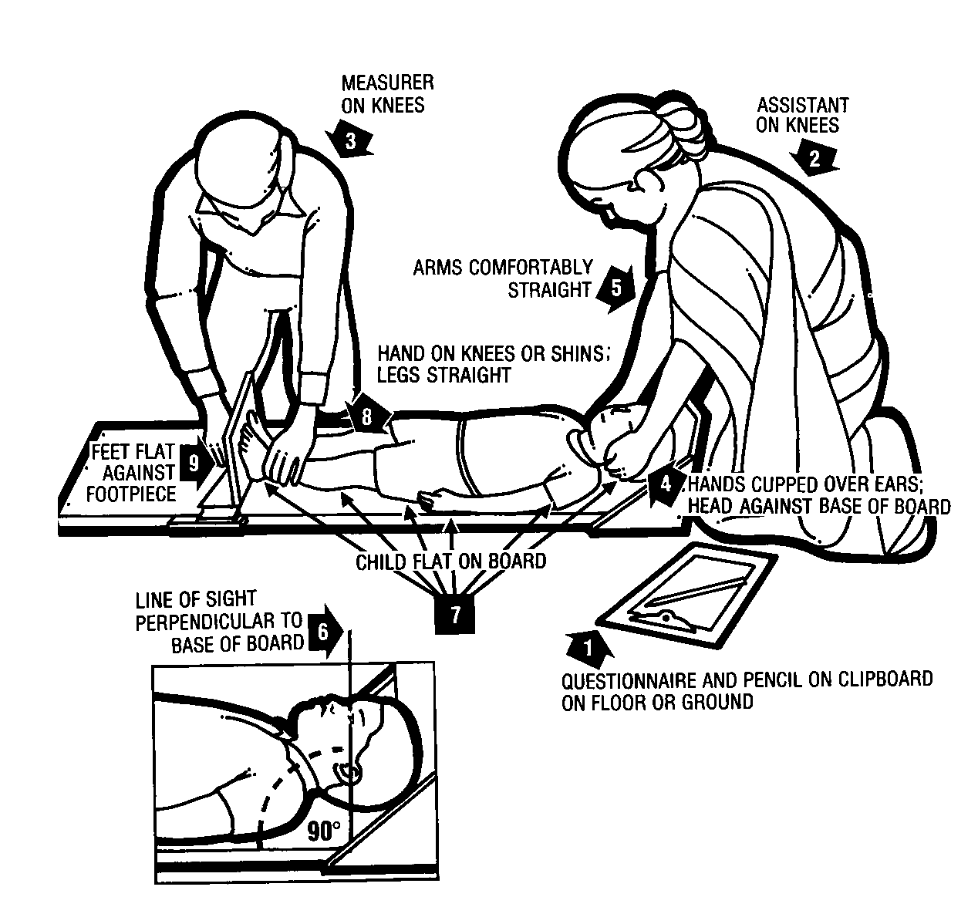

Slide 20
To measure Height:
  Use a stadiometer with a vertical back board, a fixed base board, and a movable head board.
  The stadiometer should be placed on a levelled floor.
  Remove the child’s socks and shoes for accurate measurement.
  Also remove hair ornaments and undo braids if they interfere with measurement.

Slide 22
Indicators
These three measurements are combined to form three indicators of nutritional status
  Weight for age
  Weight for height
  Height for age

Slide 23
Indices
W/A: combined measurement:
  NO individual diagnosis but trend assessment
  For growth monitoring
W/H: indicates degree of wasting
  Individual diagnosis
  Community diagnosis
  Sensitive to change
H/A: indicates linear growth retardation(stunting)
  not sensitive to change
  slow progress
  Community diagnosis

Slide 24
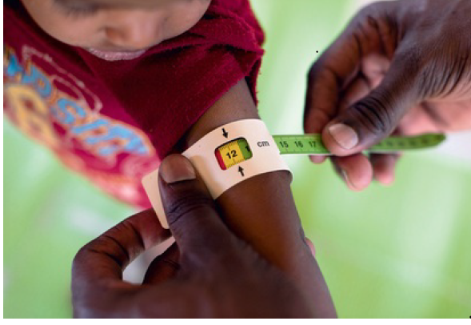
MUAC
Advantages
easy to perform
"best" predictor of mortality in children
Disadvantages:
measurement error
age dependency
Classifications: 6 -59 months based on MUAC
< 11.5 cm--------------SAM
11.5 - < 12.5 cm------MAM
> 12.5 cm--------------No Malnutrition

Slide 25
Cont…
  Measure mid-upper arm circumference
  MUAC is measured on the upper left arm.
  To locate the correct point for measurement,
  • The child’s elbow is flexed to 90°, with the palm facing upwards.
  • A measuring tape is used to find the midpoint between the end of the shoulder (acromion) and the tip of the elbow (olecranon) this point should be marked.
  • The arm is then allowed to hang freely, palm towards the thigh,
  • The measuring tape is placed snugly around the arm at the midpoint mark.
  • The tape should not be pulled too tight or too loose.
  • Read the measurement to the nearest 0.1 cm.

Slide 26
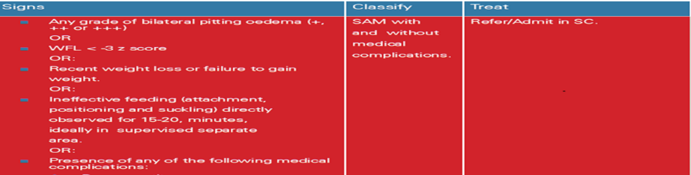
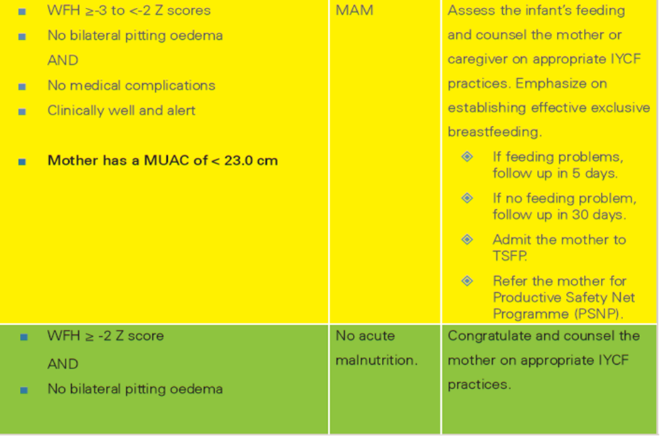
Assessing and Classifying Acute Malnutrition in Infants 0-6 Months

Slide 27
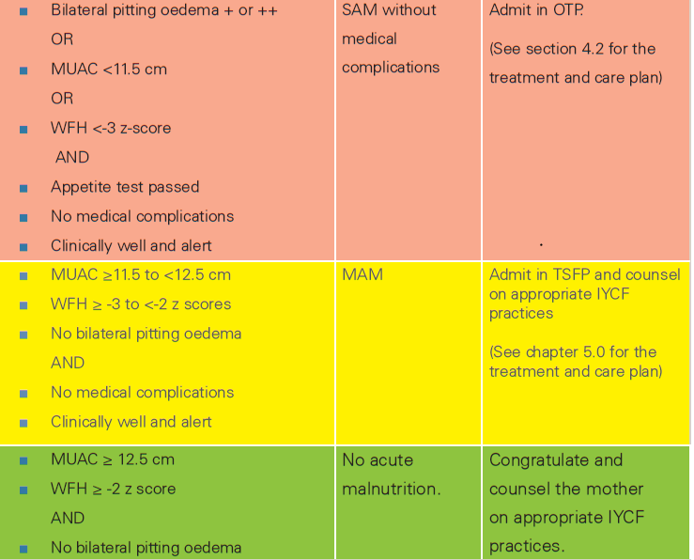
Criteria for classification of acute malnutrition among children 6 to 59 months of age

Slide 28
Classification
1)The origin of PEM can be
Primary malnutrition
  Resulted from inadequate food intake(food insecurity).
Failure of lactation.
Poverty.
Cultural patterns.
Lack of immunization & primary care.
Lack of family planning.

Slide 29
Secondary malnutrition
  Resulted from increased nutrient needs, decreased nutrient absorption, and/or increased nutrient losses.
Infections.
congenital diseases.
Malabsorption.
Metabolic causes.
Psycho social deprivation.

Slide 30
Classification…
2) CLINICAL PRESENTATION
  Edematous / Kwashiorkor
  Non edematous / Marasmus
  Marasmic-kwashiorkor
3) DURATION
  acute (Wt/Ht)
  chronic (Ht/age)
4) SEVERITY
  MAM
  SAM

Slide 31
Recognize signs of acute malnutrition
Cause
Severe deficiency of both calories and protein
Visible severe wasting(marasmus)
Bilateral pitting edema(kwashiorkor)
Dermatosis(+,++,++)
Eye signs
Flag sign
And others
Mainly protein deficiency

Slide 32
Checking for Bilateral Pitting Oedema

Slide 33
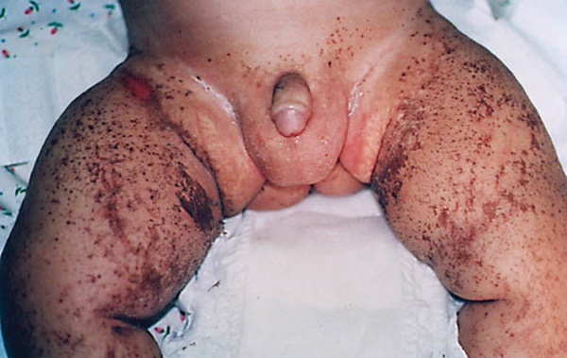
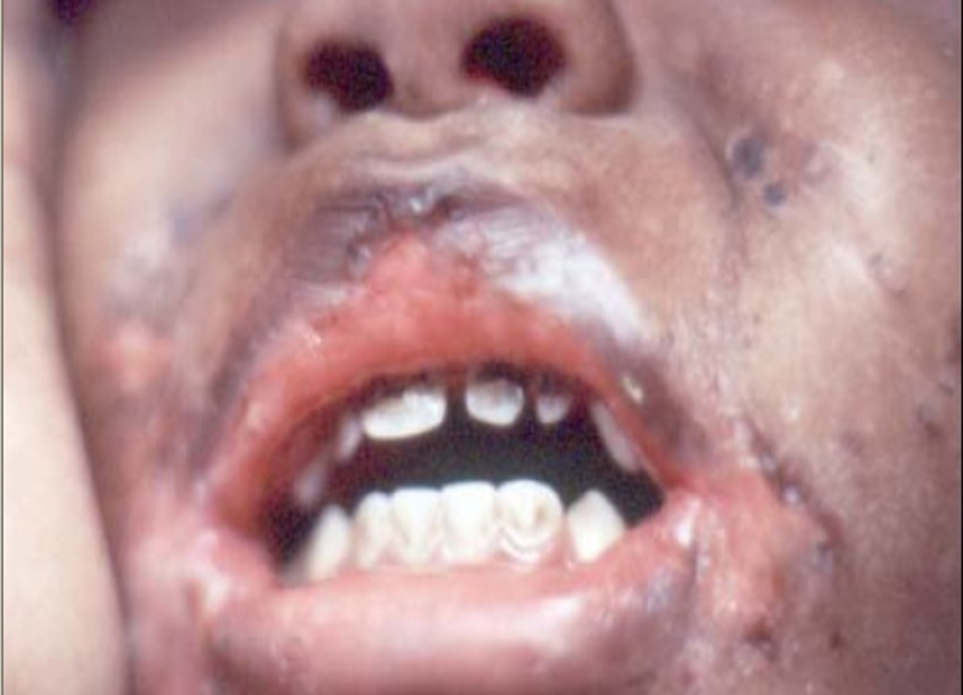
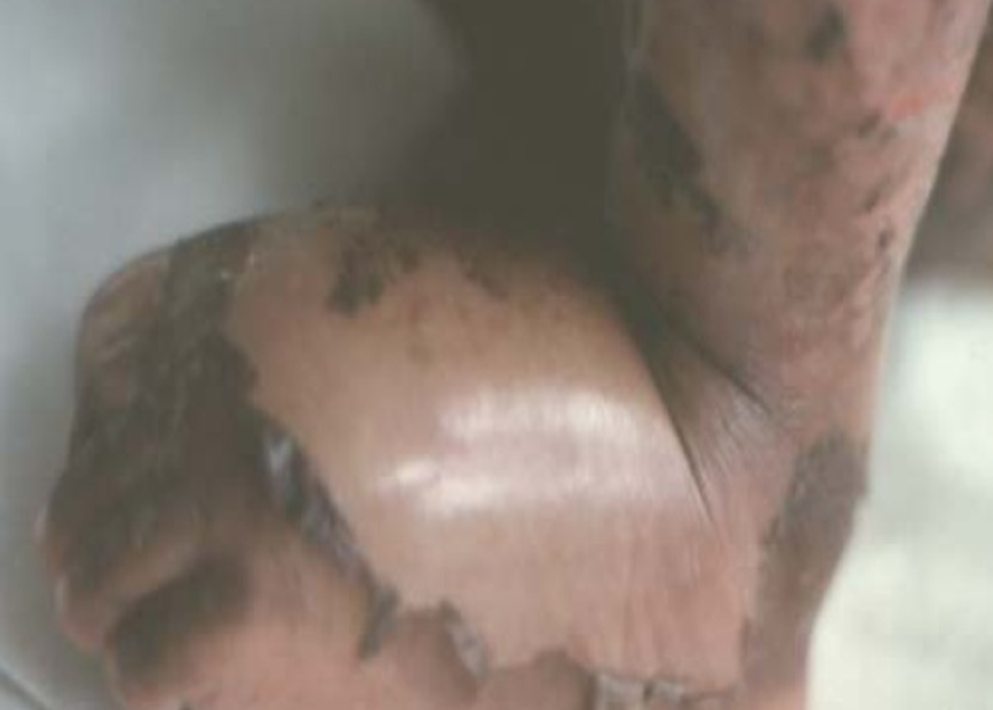
dermatosis

Slide 34
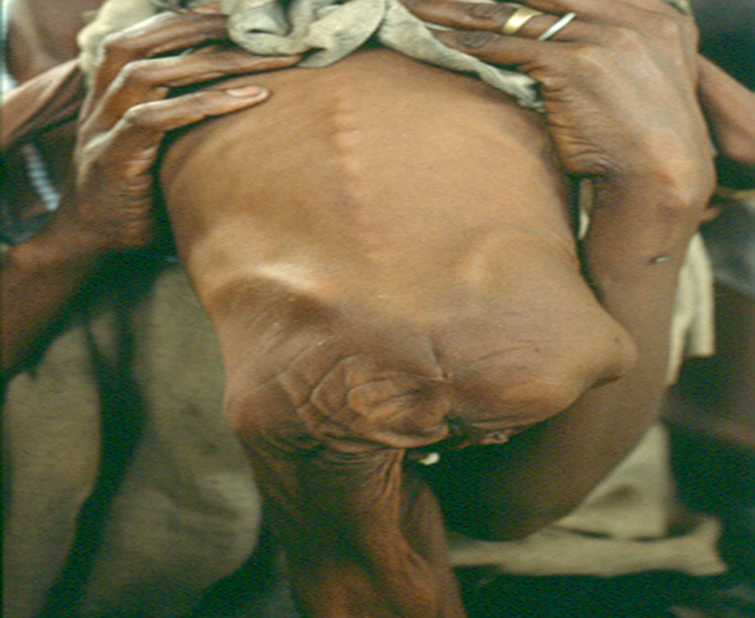
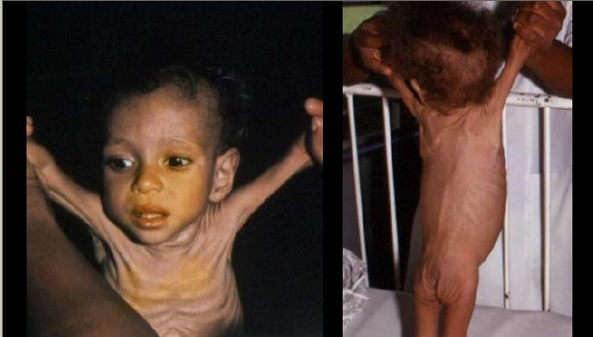

Slide 35

Flag sign

Slide 36
How does the physiology of severe acute malnutrition affect care of the child?
What is reductive adaptation?
  The systems of the body begin to “shut down” with severe malnutrition.
  The systems slow down and do less in order to allow survival on limited calories. This slowing down is known as reductive adaptation.
  As the child is treated, the body’s systems must gradually “learn” to function fully again.
  Rapid changes (such as rapid feeding or fluids) would overwhelm the systems, so feeding must be slowly and cautiously increased.

Slide 37
Decrease in energy intake ➔ decrease in energy expenditure,
  Metabolism of body fat → weight loss
The poor availability of dietary proteins ➔Reduces protein synthesis loss of body protein(catabolism), primarily from skeletal muscle →Muscular wasting
Adaptations lead to the
  Sparing of essential body proteins &
  Preserve essential protein dependent functions until the nonessential tissue proteins are depleted

Slide 38
Why edematous SAM develops in some children and non-edematous SAM develops in others is unknown.
Possible explanations
The variability among infants in nutrient requirements & in body composition at the time the dietary deficit is incurred.
Giving excess carbohydrate to a child with non-edematous SAM reverses the adaptive responses to low protein intake, resulting in mobilization of body protein stores. Eventually, Albumin synthesis decreases, resulting in hypoalbuminemia with edema. Fatty liver also develops secondary, perhaps, to lipogenesis from the excess carbohydrate intake and reduced apolipoprotein synthesis.

Slide 39
  Aflatoxin poisoning as well as diarrhea, impaired renal function & decreased Na+ K+ ATPase activity.
  4. Free radical damage has been proposed as an important factor in the development of edematous SAM. This proposal is supported by low plasma concentrations of methionine, a dietary precursor of cysteine, which is needed for synthesis of the major antioxidant factor, glutathione. This possibility also is supported by lower rates of glutathione synthesis in children with edematous compared with non-edematous SAM.

Slide 40
End organ effects of malnutrition
Body composition
  Muscle and fat loss
  Increased Na+
  Decreased K+ and Mg++
  Total body water increases (ECF)
GIT
  Villus atrophy
  Production of gastric acid is reduced
  Decreased intestinal motility
  Pancrease is atrophied and reduced enzymes
  Bacterial over growth

Slide 41
End organ effects of malnutrition
Liver
  Reduced synthesis of protein
  Impaired gluconeogenesis
  Decreased metabolism of toxins and substances
Cardiac
  Myocardial atrophy, reduced CO, decreased BP
Renal
-GFR is reduced
-Reduced excretion of excess water, Sodium and phosphate
Hematology : anemia
Metabolic
  Hypoglycemia and Reduced metabolic rate by 30%.

Slide 42
End organ effects of malnutrition
Immunity
  Impaired especially the Cell mediated
  Reduced Ig A
  Complement components are low
  Reduced phagocytosis
  Lymph glands, tonsils and the thymus are atrophied
Inflammatory response
  Impaired acute phase response
  Reduced chemotaxis of WBC to site of infection/ inflammation
  Prone to infectious agents/subtle signs

Slide 43
Cont…
  Endocrine system
  -Insulin levels are reduced and the child has glucose intolerance
  -IGF-1 levels are reduced, although growth hormone levels are increased
  -Cortisol levels are usually increased
  -T3 and T4 decreased

Slide 44
Cont…..
Skin, muscles and gland
  -The skin and subcutaneous fat are atrophied, which leads to loose folds of skin
  - Eyes may be sunken because of loss of subcutaneous fat in the orbit
  - Many glands are atrophied the child has dryness of the mouth and eyes and sweat production is reduced .
  -Atrophy of hair roots of the scalp

Slide 45
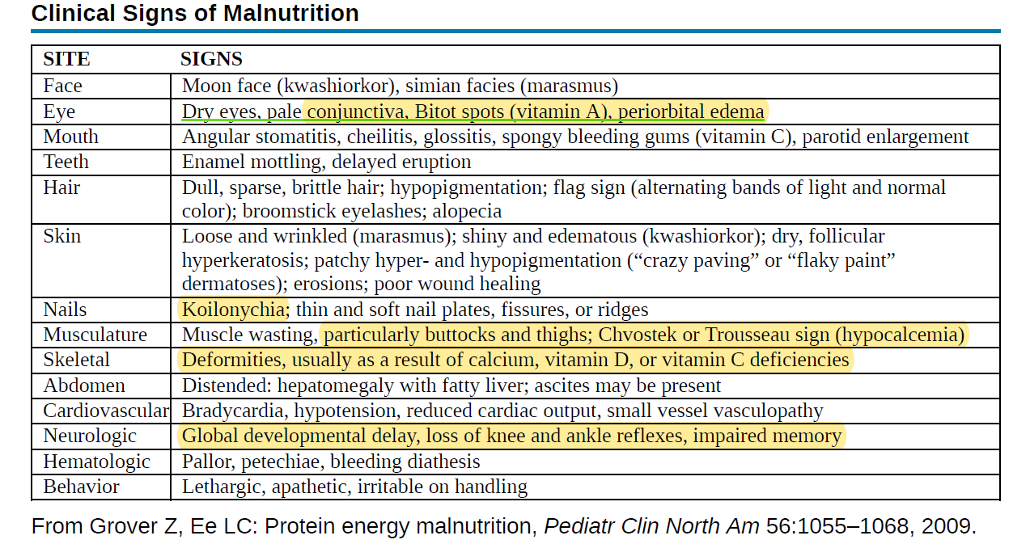
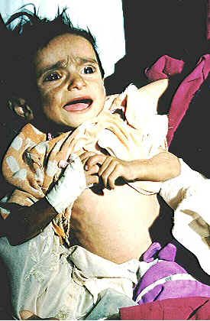
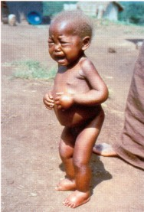

Slide 46
Laboratory studies
Blood glucose
Hgb or HCT
Blood film
PIHCT
Stool microscopy
Urine analysis and culture
Chest x-ray
Tests for tuberculosis
Serum concentrations of total proteins specially albumin
Electrolytes

Slide 47
Mgt of severe acute malnutrition
Admission
Inpatient mgt
  Stabilization phase
  Transition phase
  Provide Sensory Stimulation and Emotional Support
Discharge
  Rehabilitation (catch up diet for rapid growth)
Follow up

Slide 48
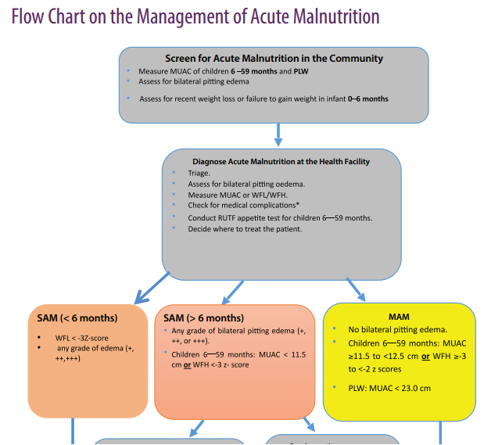
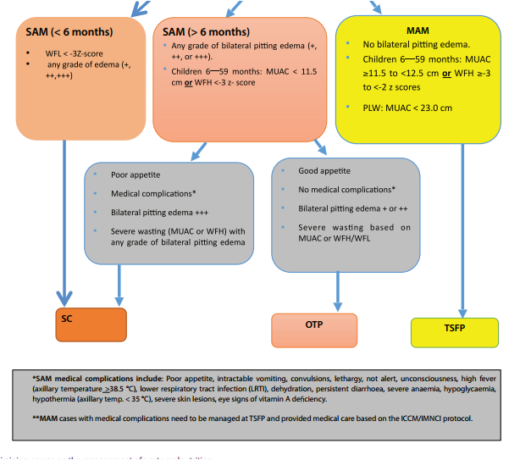

Slide 49
Assessment and classification for Admission
All children who fulfil any of the following criteria have SAM and
They should be admitted to a Therapeutic Feeding Program (SC or OTP).
Infants less than six months:
• Weight –for- Length (WFL) < -3Z score OR
• Presence of any grade of bilateral pitting edema
Children 6 to 59 months:
• Weight –for- Length (WFL) / WFH < -3Z score OR
• Presence of bilateral pitting edema OR
• MUAC <11.5 cm

Slide 50
Cont…
  In-patient care (SC): All children with SAM need to be treated in an in-patient care facility if they fulfil any one of the following.
  1) Infants below six months of age with SAM OR
    2) Grade +++ edema OR
    3) Mixed type of malnutrition(marasmic - kwash) OR
    4) Children 6 to 59 months with SAM who have any one of the medical complications OR
    5) Children 6 to 59 months with SAM who have failed appetite test OR Children with SAM and referred from OTP for in-patient care

Slide 51
SC Entry category
New admissions :-New case who meets the admission criteria for SC
Readmission
Relapse:- Cured within the past 3 months and now meets the admission criteria for SC
Returned defaulters :-Defaulted within the past 3 weeks and has returned to continue treatment in SC.
Transfers-in :-Referred to the SC because condition deteriorated in OTP or has moved in from another facility where s/he was receiving care in SC.

Slide 52
Goals of management
Resolving life-threatening complications
Restoring nutritional status without disrupting homeostasis
Ensuring nutritional rehabilitation

Slide 53
Complications
How to diagnose and treat?

Slide 54
Treatment of complications in SAM
Hypoglycemia
Hypothermia
Dehydration
Hypovolemic shock
Septic shock (infection)
Heart Failure
Severe anemia
Electrolyte imbalance
Micronutrient deficiencies
K. Dermatosis,
Corneal clouding and ulceration
Abdominal distension
Notes:
Absent bowel sounds, gastric dilatation and intestinal splash with abdominal distension

Slide 55
Treatment of Hypoglycemia
Blood glucose <3 mmol/L (<54 mg/dl)
Important cause of death in 1st 2 days
Hepatic energy production from galactose and fructose is much slower
Gluconeogenesis is limited
Serious infection, not fed in the last 4-6hr, vomited or too weak to fed or waiting for admission
S/S include : hypothermia, limpness/drowsiness, lethargy, loss of consciousness, lid retraction
Note: -Sweating and pallor may not occur in malnourished children with hypoglycemia. Often the only sign before death is drowsiness.

Slide 56
Treatment of hypoglycemia
  Give 50ml bolus of 10% glucose or 10% sucrose orally.
  If the child is alert, but not drinking, give the 50ml by NG tube.
  If child is lethargic, unconscious or convulsing, give 5ml/kg body weight of 10% glucose IV followed by NG tube.
  Start feeding F-75 half an hour after giving glucose and give it every half-hour during the first 2 hours. The amount being ¼ of the 3 hourly amount.
  Recheck the RBS level after 2 hours and
    If RBS is >=54mg/dl, change 3-hourly feeds (8 feeds per day) of F-75
    If it is still low, make sure antibiotics and F-75 have been given. Keep giving F-75 every half-hour and treat with second line antibiotics.

Slide 57
Prevent/treat Hypothermia
Rectal temp <35.5dc or axillary <35dc
Children should always sleep with their caretakers, dry well after bath, keep away from open window, cover head
Feed F-75 every 2 hours, starting straight away.
Always give feeds throughout the day and night
Keep warm- cover at night kangaroo technique, wrap with mother, hot drinks to mother, blanket
Keep room temperature 28-32 dc
Treat hypoglycemia
Give second line antibiotics/treat infection

Slide 58
Diagnosis and Treatment of DHN
Misdiagnosis of dehydration & giving inappropriate treatment is the commonest cause of death in severe malnutrition
All signs of dehydration in a normal child occur in a severely malnourished child who is not dehydrated
Mainly based on history of significant fluid loss/diarrhea & recent change in child’s appearance-sunken eyes proven by mother rather than PE
Diagnosis is presumptive not definite

Slide 59
Treatment of dehydration
Never use the standard protocol for well nourished child & not ORS but RESOMAL
Whenever possible hydrate only orally
IV fluids are dangerous, use only if there is shock with loss of consciousness from confirmed dehydration
Re-Hydrate the child until wt deficit is corrected (usually 5%)
Give 5 ml/kg Q30min for 1st 2 hours then 5-10 ml/kg/hour alternate hours with F75 for 10 hours.

Slide 60
DHN cont….
If diarrhoea continues, give ReSoMal after each watery diarrhoea to replace stool losses and prevent dehydration:
• < 2 years: give 50-100 ml after each watery stool
• 2 years and older: give 100 – 200 ml after each watery stool.
All edematous children have high water and sodium retention hence over hydrated.
If there is definite watery diarrhea and child clinically deteriorating-replace with Resomal 30 ml per watery diarrhea.
NB:-In cases of profuse (acute) watery diarrhoea (e.g. cases of cholera), should be replaced by a standard ORS without changing the amounts and frequency

Slide 61
ReSoMal
An oral rehydration solution developed for use in severely malnourished children.
It consists of the standard WHO rehydration oral solution (ORS) that has been modified by decreasing sodium and increasing potassium concentrations .
This solution is used to correct the hypernatremia and potassium deficiency that occur in severe malnutrition.
This solution also can be made by diluting one packet of the standard WHO-recommended ORS in 2liters of water and adding 50 g(4 tablespoons) of sucrose (25 g/L) and 40 mL (20 ml/L) of mineral mix solution.
Notes:
ReSoMal is available commercially.

Slide 62
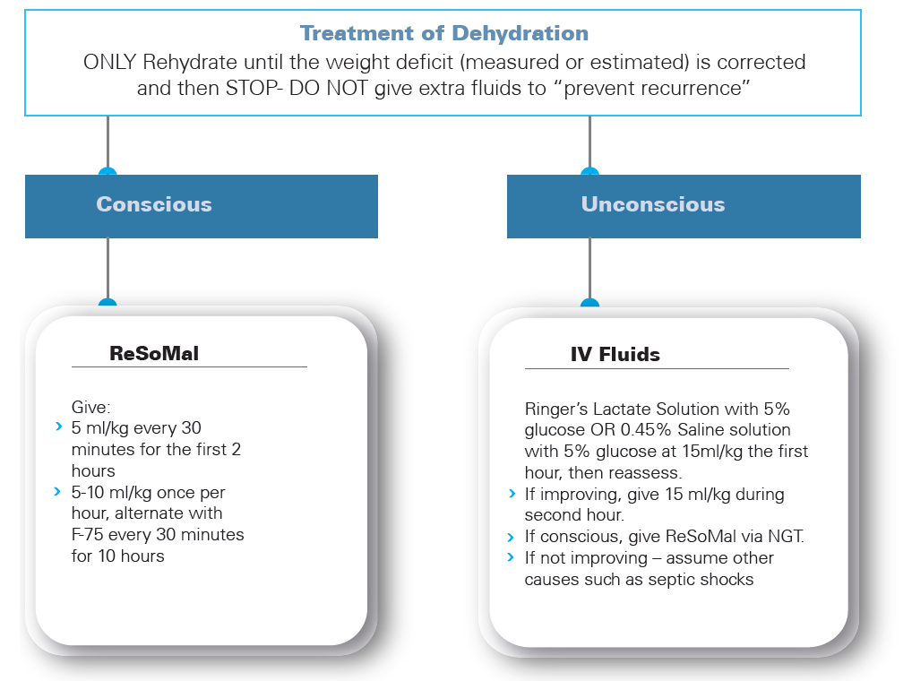

Slide 63
Monitor the child who is taking ReSoMal
Monitor progress every half hour for the first two hours and then monitor hourly
Signs to check
• Respiratory rate - Count for a full minute.
• Pulse rate - Count for 30 seconds and multiply by 2.
• Weight
• Urine frequency
• Liver size: mark before any infusion
• Stool or vomit frequency
• Signs of hydration - Is the child less lethargic or irritable?

Slide 64
Cont…
Signs of improving hydration status
• less thirsty
• less lethargic
• Slowing of rapid respiratory and pulse rates
• Passing urine
• Gaining weight with clinical improvement
If a child has three or more of the above signs of improving hydration status, stop giving ReSoMal.

Slide 65
Cont…
Signs of over hydration
Stop ReSoMal if any of the following signs appear:
• Child’s weight exceeds the target weight
• Increased respiratory rate by 5 breaths and pulse rate by 25 beats per minute.(Both must increase to consider it a problem.)
• Jugular veins engorged. (Pulse wave can be seen in the neck.)
• Sudden increase in liver size and tenderness
• Increasing oedema (e.g., puffy eyelids).
• Increasing weight with clinical deterioration

Slide 66
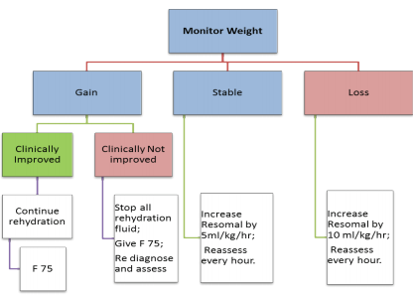
Monitoring algorithm for a child on ReSoMaL

Slide 67
Management of Shock in SAM patient
The severely malnourished child is considered to have shock if he/she is lethargic or unconscious and has cold hands
plus either
slow capillary refill* (longer than 3 seconds), or
weak, fast** or absent radial or femoral pulses’
The four key steps to manage shock are
1. Give oxygen
2. Give 10% Glucose 5 ml/kg by IV
3. Keep the child warm
4. Give IV fluids

Slide 68
Cont…..
Use IV fluid-R/L with 5% dextrose or half strength(0.45%) NS with 5% dextrose
Add 125 ml of 40% or 100 ml of 50 % glucose to 1 litter of 0.9% NS to make this fluid.
If either of these are used, add sterile potassium chloride (20 Mmol/l) if possible
Give 15 ml/kg over 1st hour & reassess, if still weight loss or stable weight repeat the same until weight gain but if no improvement assume septic shock and transfuse.
As soon as child is conscious with good pulse-stop IV, give oral or by NGT
Give 5-10 ml/kg ReSoMal per hour and continue to give F-75 alternate hours for up to 10 hours
No IV drip near SAM patient who can drink or use NGT.

Slide 69
Rx of septic shock
Give maintenance IV fluids (4 ml/kg/hour) while waiting for blood.
When blood is available, stop all oral intake and IV fluids,
Give a diuretic(furosemide 1mg/kg) to make room for the blood, and then transfuse whole fresh blood at 10 ml/kg slowly over 3 hours.
If there are signs of heart failure, give packed cells instead of whole blood as these have a smaller volume
Give second & first line antibiotics together – IV
Keep warm to prevent or treat hypothermia
Give sugar water to prevent hypoglycemia – orally /NG tube
If improved → F75

Slide 70
Mgt of very Severe anemia
If Hgb < 4 gm/dl or Hct <12%
Give blood transfusion in the first 48 hours if:
•Hgb is < 4 g/dl, (Hct is < 12 %), or
•Hgb 4 to 6 g/dl (Hct 12 to 18%) and respiratory distress
Give Packed cell/whole blood 10ml/kg over 3 hrs.
Keep child NPO during and 3 hours after transfusion
Do not transfuse a child b/n 48 hours and 14 days unless there is heart failure.
No Iron treatment in the first phase

Slide 71
Why no iron early in treatment ?
Due to reductive adaptation, the severely malnourished child makes less Hgb than usual due to protein deficiency.
Iron that is not used for making Hgb is put into storage.
Thus, there is “extra” iron stored in the body
So giving iron early in treatment will not cure anemia, as the child already has a supply of stored iron. Which leads to “free iron” in the body which can cause problems in three ways:
  Free iron is highly reactive and promotes the formation of free radicals, which may engage in
  uncontrolled chemical reactions with damaging effects.
  Free iron promotes bacterial growth and can make some infections worse.
  The body tries to protect itself from free iron by converting it to ferritin. This conversion requires energy and amino acids and diverts these from other critical activities.
  Later, as the child recovers and begins to build new tissue and form more red blood cells, the iron in storage will be used and supplements will be needed.

Slide 72
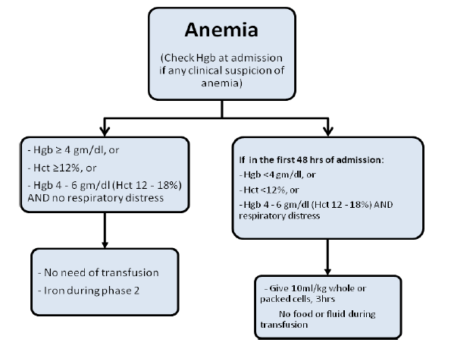

Slide 73
Management of heart failure
Diagnosis
  • Physical deterioration(Increase in RR & PR) with weight gain
  •Sudden increase in liver size
  •Tenderness of the liver
  •Crackles in lungs, grunting
  •Prominent superficial and neck veins
  •Engorgement of the neck veins when the abdomen (RUQ) is pressed,
  •Increased or reappearance of edema, among other clinical signs and symptoms.
Pneumonia is less likely in a child with RD after wt gain
Notes:
HF when?

Slide 74
Treatment of heart failure
Stop all oral or IV intakes/No fluid or food for 24-48 hours until managed
Give sugar water to prevent hypoglycemia
Furosemide 1 mg/kg single dose , repeat if necessary.
If there is also severe anemia, treat the HF first than the anemia

Slide 75
Give emergency eye care
Eye signes
Bitots’ spots – superficial foamy white spots on the conjunctiva (white part of the eye).
Pus and inflammation (redness) are signs of eye infection.
Corneal clouding is seen as an opaque appearance of the cornea (the transparent layer that covers the pupil and iris).
Corneal ulceration is a break in the surface of the cornea .If not treated, the lens of the eye may push out and cause blindness.
Corneal ulceration is urgent and requires immediate treatment with vitamin A and atropine (to relax the eye)

Slide 76
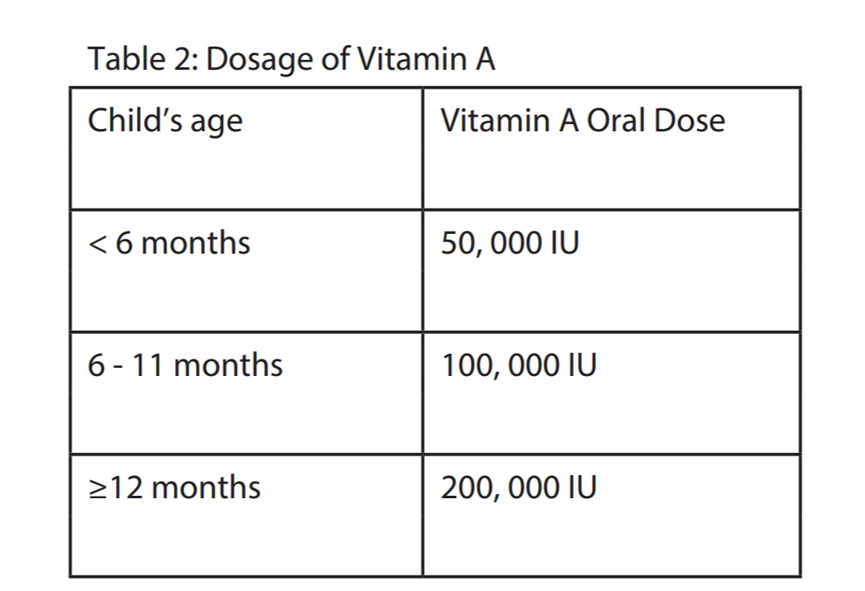
  Give vitamin A
  Vitamin A doses are given on Day 1 and Day 2, Day 15 if:
  • The child has visible clinical signs of vitamin A deficiency
  • The child has signs of eye infection (pus, inflammation)
  • The child has measles now or has had measles in the past 3 months
  • The child has persistent diarrhoea
You should instil one drop atropine (1%) into the affected eye(s) to relax the eye and prevent the lens from pushing out (for corneal clouding and corneal ulcer)
Tetracycline eye drops and bandaging are also needed

Slide 77
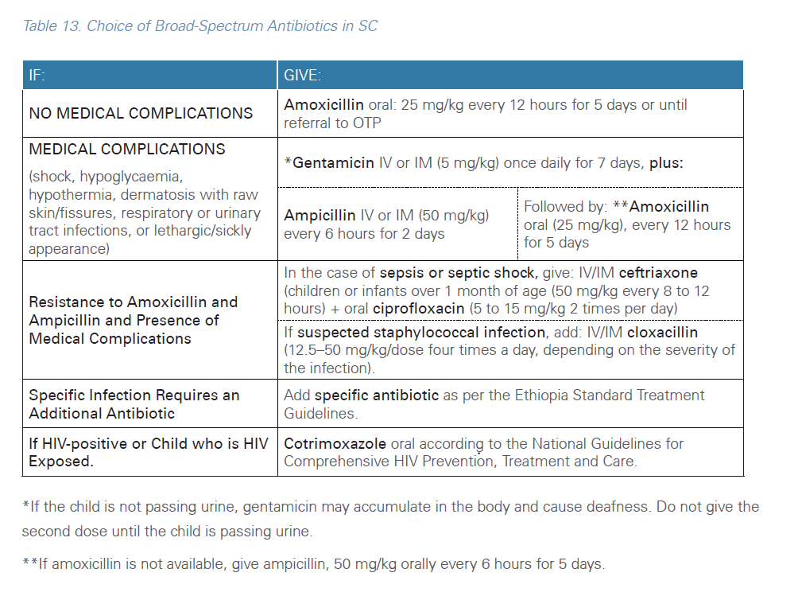
Treat Infections
Give all severely malnourished children antibiotics for presumed infection even if they do not have clinical sign of systemic infections.

Slide 78
Management of SAM in TB and HIV pt
Management of SAM is the same
Start nutritional treatment at least a week before ART, anti TB (except miliary TB) until the liver, pancreas and intestine have recovered sufficiently to metabolize the drugs safely
If it is must to start in Phase I start with reduced dose
Cotrimoxazole preventive therapy will not replace amoxicillin.
Avoid toxic drugs
Standard doses of drugs for HIV/TB are used in PII/OTP

Slide 79
Management of Abdominal distension
Abdominal distension can occur because of reduced gastrointestinal motility due to electrolyte disturbance (Hypokalaemia).
The following measures should be taken:
• Give Gentamicin IV once daily plus Ampicillin IV every 6 hours
• Consider adding Ceftriaxone IV
• Stop all other drugs that may be causing toxicity (such as metronidazole)
• Give a single IM injection of magnesium sulphate (2ml of 50% solution).
• Pass an NG-tube and aspirate the contents of the stomach, then “irrigate” the stomach with 50 ml of isotonic clear fluid (5% dextrose or 10% sucrose –the solution does not need to be sterile). This should be repeated until the fluid that returns from the stomach is clear.

Slide 80
Cont…..
Put 5 ml/kg of sugar-water (10% sucrose solution) into the stomach and leave it there for one hour. Then aspirate the stomach and If the volume is less than the amount that was introduced, then either a further dose of sugar-water should be given or the fluid returned to the stomach.
• There is frequently gastric and oesophageal candidiasis: give oral nystatin suspension or fluconazole.
• Keep the child warm.
• If the child’s level of consciousness is poor give intravenous glucose,
• Monitor the child carefully for 6 hours, without giving any other tt
• Improvement is measured by a change in intestinal function and by improvement in the general condition of the child.

Slide 81
If there is intestinal improvement:
• Start to give small amounts of F-75 by NG tube (half the quantities)
If there is no improvement after 6 hours:
• Consider putting up an IV drip.
Use Ringer-Lactate in 5% dextrose or half-strength saline in 5% dextrose. Kcl (20mmol/l) should be added to all solutions that do not contain potassium.
The drip should be run VERY SLOWLY and should be not more than 2 to 4 ml/kg/h.
• When the gastric aspirates decrease so that one half of the fluid given to the stomach is absorbed, discontinue the IV treatment and continue with oral treatment

Slide 82
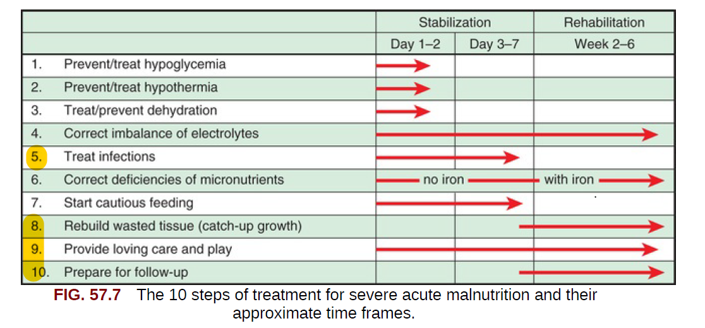
Cont ……

Slide 83
The Do NOT DOs
Do NOT give DIURETICS to treat Edema
Do NOT give IRON during the Initial feeding phase
  Add iron only after the child has been on F100 for 2 days
Do NOT provide high protein formula(over 1.5 gm/kg/day) in initial phase
Do NOT give IV Fluids routinely

Slide 84
FEEDING
Cautious feeding is a critical part of managing SAM patients.

Slide 85
Stabilization Phase (phase I)
Required because of the patient’s fragile physiological state and reduced homeostatic capacity.
Life-threatening medical complications are treated
We don’t expect wright gain in this phase.
Routine drugs are given to correct specific deficiencies
Give small, frequent feeds of F-75(starter formula) every 2 hours, orally or by NGT including night.
F-75 contains 75 kcal and 0.9 g protein per 100 ml.
After the first day, increase the volume per feed gradually so that the child’s system is not overwhelmed.
If breastfed child, encourage the child to continue breastfeeding.

Slide 86
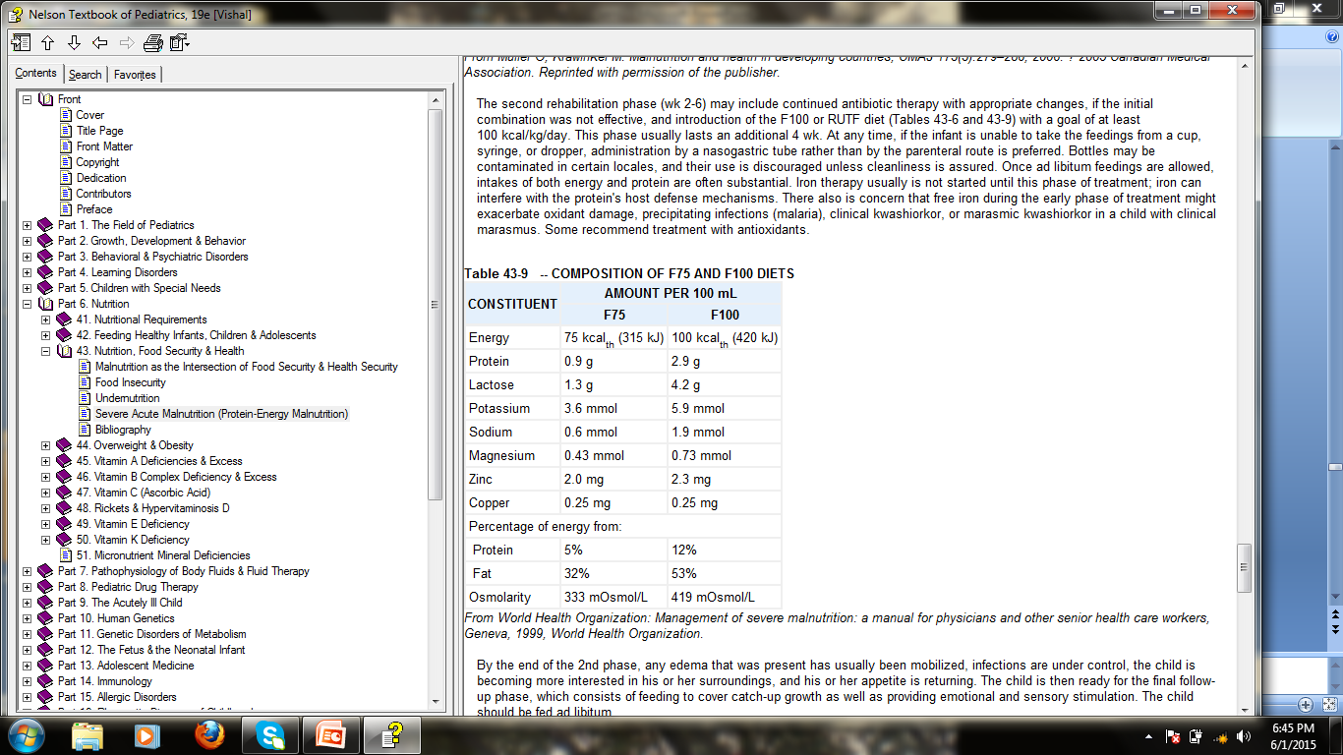

Slide 87
Feeding and NGT use
Indications for NGT use
  Taking <80% of prescribed milk in 24 hrs in P-1
  Pneumonia with rapid RR/Respiratory distress
  Cleft palate or other oral deformities
  Painful mouth lesions
  Unconscious or lethargic child
Use NGT only in P-I and for maximum of 3 days, try oral feeding at every feeding

Slide 88
Cont…
Criteria for change of volume and frequency of F-75 feeds
• If vomiting, lots of diarrhoea, or poor appetite, continue 2-hourly feeds.
• If little or no vomiting, modest diarrhoea (for example, less than 5 watery stools per day), and finishing most feeds, change to 3-hourly feeds.
• After a day on 3-hourly feeds: If no vomiting, less diarrhoea, and finishing most feeds, change to 4-hourly feeds.

Slide 89
Criteria to move to transition phase
Return of appetite(easily finishes F-75)
Reduced Edema
Clinically well
No NGT or IV line

Slide 90
Transition Phase
When the child is stabilized (usually after 2 to 7 days), the “catch-up” formula F-100/ RUTF is used to rebuild wasted tissues.
F-100 contains more calories and protein: 100 kcal and 2.9 g protein per 100 ml.
Transition can take around 2 to 3 days, during which RUTF is introduced alongside F-75.
Increase the amount of RUTF over 2–3 days until the child takes the full requirement of RUTF.
If the RUTF is not available or if the child does not accept it, give F-100 equal to the quantity of F-75 given in Phase 1
Expected weight gain should be around 6 g/kg/day

Slide 91
Criteria to Move Back from the Transition Phase to the Stabilisation Phase
Weight gain of more than 10 g/kg/day in association with an↑ in RR
Increasing or developing oedema
A rapid increase in the size of the liver
Any sign of fluid overload
Tense abdominal distension
A complication that necessitates an IV infusion
A need for feeding by NGT
Significant refeeding diarrhoea leading to weight loss

Slide 92
Criteria to Move from the Transition Phase to Rehabilitation
A good appetite: Passes the appetite test and takes entire amount of the daily RUTF ration or takes all amount of F-100 .
Oedema reduced to moderate (++) or mild (+).
If wasting with bilateral pitting oedema, oedema should completely disappear.
Medical complications are resolving.
Clinically well and alert.

Slide 93
Rehabilitation phase
(Catch-up Diet for Rapid Growth)
Whenever patients have good appetite and no major medical complication they enter Phase 2
Give RUTF (used in both in-patient & out-patient settings) or F100 (used in in-patient setting only) .
Expected weight gain is at least 10g/kg/day.
Patients who consume RUTF should be transferred from SC to OTP and monitored weekly at a facility close to his/her home
If no possible referral for outpatient care, feed freely with F-100 to upper limit of 220 kcal/kg/day during rehabilitation
Most children will consume at least 150 kcal/kg/day; any amount less than this indicates that the child is not being fed freely or is unwell..
Start deworming and iron supplementation

Slide 94
Move back from rehabilitation phase stabilization phase
Failure of the appetite test
Increase/development of edema
Develops any signs of a complication
Development of refeeding diarrhoea sufficient to lead to weight loss.
Fulfilling any of the criteria of “failure to respond to treatment”
Weight loss for 2 consecutive weighing
Static weight for 3 consecutive weighing
Notes:
Major illness or death of the main caretaker so that the substitute caretaker requests inpatient care

Slide 95
Cont…
When do we say the child failed to respond
• Failure to regain appetite after 4 days
• Failure to start to lose edema after 4 days
• Edema still present after 10 days
• Failure to gain at least 5 g/kg/day for 3 successive days after feeding freely on F-100
Note: The day of admission is counted as day 0

Slide 96
CAUSES OF FAILURE TO RESPOND
Problems with the treatment facility
Problems of individual children

Slide 97
Problems with the treatment facility
In-patients
  Poor environment for malnourished children
  Failure to treat the children in a separate area
  Failure to complete the multichart correctly
  Insufficient staff (particularly at night)
  Poorly trained staff
  Inaccurate weighing machines
  Food prepared or given incorrectly
Out – patients
  Inappropriate selection of patients to go directly to OTP
  Poorly conducted appetite test
  Inadequate instructions given to caretakers
  Wrong amounts of RUTF dispensed to children
  Excessive time b/n OTP distributions (e.g. two weekly gives significantly worse results than weekly visits)

Slide 98
Problems of individual children
In –patients
  Insufficient food given
  Food taken by siblings or caretaker
  Sharing of caretaker’s food
  Vitamin or mineral deficiency
  Malabsorption
  Psychological trauma (particularly in refugee situations and families living with HIV/AIDS)
  Rumination
  Infections
  Other serious underlying disease:
    Congenital abnormalities (e.g. Down’s syndrome),
    Neurological damage (eg cerebral palsy),
    Inborn errors of metabolism.
Out–patients (In addition to all of the above)
  Sharing within the family
  Sibling rivalry (other children taking the diet)
  All eating from the same plate (the malnourished child should always have his/her own portion of food).
  Unwilling caretaker
  Caretaker overwhelmed with other work and responsibilities

Slide 99
The discharge criteria for children age 6-59 months
Discharged after Full Recovery (CURED) in SC:
Note: The same anthropometric indicator that is used to identify and confirm SAM on admission should be used to determine recovery and discharge from treatment.
If admitted with bilateral pitting edema , discharge cured when
• No bilateral pitting edema for 2 weeks
• AND MUAC ≥ 12.5 cm or WFH/WFL ≥ -2 z-score
• AND Clinically well and alert
If admitted with MUAC discharge as cured when
• MUAC ≥ 12.5 cm
• AND No bilateral pitting edema
• AND Clinically well and alert
If admitted based on WFH/WFL, discharge cured when
• WFH/WFL ≥ -2 z-score
• AND No bilateral pitting edema
• AND Clinically well and alert

Slide 100
Feeding Infants less than 6 months
Malnourished infants less than 6 months should always be treated in inpatient facilities.
The management of complication is the same as children 6-59 months.
The feeding of infants is different from older children and it is also different for infants on breast feeding or with a caretaker willing to breast feed and for infants who cannot be breast-fed.
RUTF is not suitable for them, as the reflex of swallowing is not present yet.

Slide 101
Cont…….
Diagnostic criteria:
• Any grade of bilateral pitting edema (+, ++ or +++) OR
• WFL < -3 z score
Severely malnourished young infants need:
• Treatment with antibiotics
• Warmth to treat and prevent hypothermia.
• Nutritional support for breastfeeding which may require supplemental suckling techniques.
• Continuous monitoring of weight and feed intake.
• Psychological support to the mother or caretaker and counselling on health and breastfeeding
• Keeping mothers and infants together must be a priority for a successful recovery of the infant

Slide 102
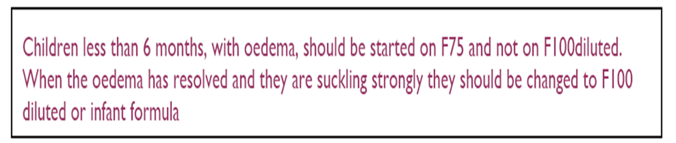
Product used
Diluted F- 100
Why Should be diluted?
  •Because babies of that age need more water and they are wasted, they need 100kcal/kg
  Should not be given undiluted F-100 at any time (owing to the high renal solute load and risk of hypernatremic dehydration).

Slide 103
Infants < six months with possibility of BF
Stabilization
  Breastfeed every 3 hours, at least for 20 minutes, more often if the child ask for more.
  One hour after breast-feeding, complete with F100 diluted using the supplementary suckling technique:
  Complete F-100 diluted: 130ml/kg/day (100kcal/kg/day),divided in 8 meals
  F-100-Diluted is prepared by adding 30% of the water, which was added to prepare the full strength F-100

Slide 104
Supplemental Suckling Technique
-The mother holds the tube at the breast with one hand and uses the other for holding the beaker.
-The supplementation is given via an NGT n°8
-F-100 diluted is put in a beaker . The end of the tube is put in a cup.
-The tip of the tube is put on the breast at the nipple and the infant is offered the breast.
-When the infant sucks on the breast with the tube in is mouth, the milk from the cup is sucked up through the tube and taken by the infant.
-The beaker is placed 5-10cm below the level of the breast so the milk does not flow too quickly and distress the infant.

Slide 105
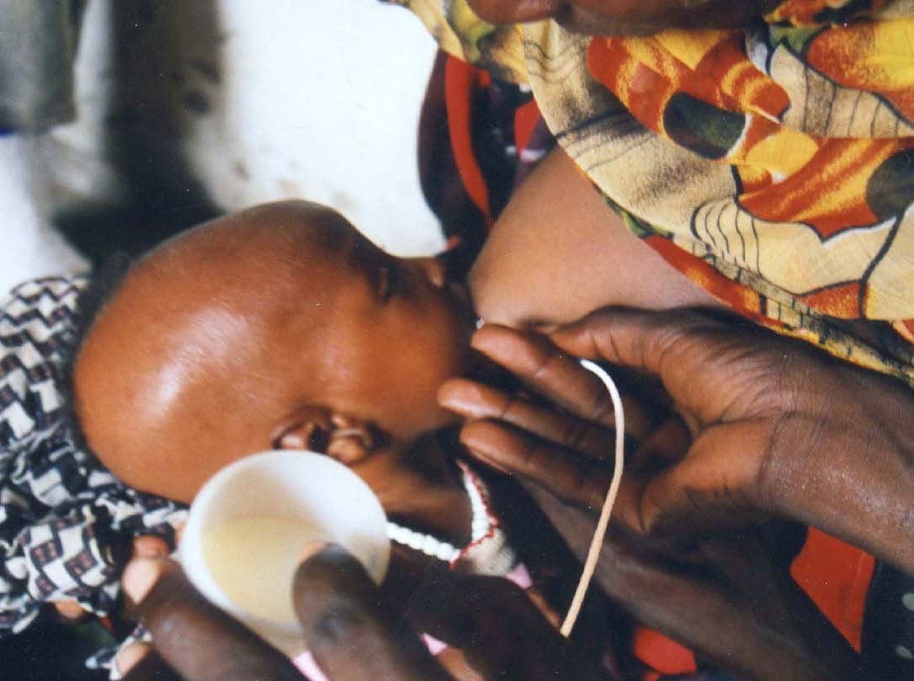

Slide 106
Cont…..
Transition
Monitor the progress of the infant in inpatient care by daily weighing.
• Decrease supplementary milk feeds by half when the child has gained at least 20g per day for 3 consecutive days and completely stop the milk when the child maintains a 10g per day weight gain and continue on breast milk alone
• If weight gain is not satisfactory when reducing the volume of milk supplement, increase the volume to the previous level for 2 days and try again.
Rehabilitation: During this phase, the child does not receive any more milk supplement and is gaining weight by EBF. Observe feedings in order to ensure that the infant is feeding well, and as often BF must be at least 20 minutes. Continue to encourage the mother.

Slide 107
Cont….
Discharge when the following criteria have been met:
• Successful re-lactation and effective breastfeeding has been achieved.
• Gaining weight on exclusive breastfeeding (i.e., more than 5 g/kg/day for at least 3 successive days).
• No bilateral pitting oedema.
• Clinically well and alert.
• Infant has been checked for immunization and other routine interventions.
• Mothers or caregivers have been linked with community-based follow-up and support.

Slide 108
Infants <six months with no prospect to breast-fed
Stabilization phase
  Appropriate replacement feeding should be given such as F-75 (for edematous) or diluted F-100 (for non-edematous) with relevant support to enable safe preparation and use.
  Give F75 or F-100 diluted using a cup and spoon base on child’s weight
  If the infant is not taking sufficient amounts of milk orally, NGT can be used (drip, using gravity not pumping).
  NGT should not be used for more than 3 days and should only be used in the initial phase when the infant is still being treated for medical conditions and/or doesn’t have appetite.
  Substantial weight gain is not expected during stabilization.

Slide 109
Cont….
Transition phase
  This phase should continue for 4-5 days
  When the infant shows the signs of recovery and is F-100 diluted:
  1. Increase the volume by 30%
  2. Monitor the infant’s weight.
  When the infant shows the signs of recovery and is taking F-75(oedematous):
  1. Give F-100-Diluted provided at 150–170 mL/kg per day, or increased by one third over the initial amount given, providing 110–130 kcal/kg per day.
  The criteria for further increasing the amount of feed given to the child are as follows.
  • A good appetite: the child is taking at least 90% of the infant formula (F-100-Diluted) prescribed
  • Complete loss of bilateral pitting edema or
  • The child has been taking these amounts for at least 2 days
  • No other medical problem

Slide 110
Cont….
Rehabilitation phase
  During rehabilitation, infants should be fed using a cup and a saucer
  After 4-5 days, increase the volume of milk rations for another 30%.
  If the infant is still hungry after finishing the ration, give him more. Increase the rations of 5 ml per meal.
  The infant’s caregiver must prepare and provide meals under supervision while the infant is in the malnutrition ward.

Slide 111
Cont….
Discharge criteria
• Infant is feeding well with the replacement feed.
• Has adequate weight gain and has a WFL ≥ -2 z-score.
• No bilateral pitting edema .
• Clinically well and alert.
• Infant has been checked for immunization and other routine interventions.
• Mothers or caregivers have been linked with community-based follow-up and support

Slide 112
SC Exit category
Cured:-Has reached the discharge criteria for SAM treatment, i.e., the special cases that were not referred to OTP
Died :-Dies while receiving treatment in the SC.
Defaulted:- Absent for two consecutive days. Default should be confirmed.
Non-responder:-Patient who remained in treatment in the SC does not reach the SAM discharge criteria after 16 weeks (4 months) in treatment.
Stabilised:- Condition has stabilised and referred to continue treatment in OTP.
Transferred-out:-Moved to another facility for further medical care or moved out to receive care in another SC

Slide 113
Daily care

Slide 114
  Handle the child gently
  Give Routine medicines and other medications
  Follow PR,RR,T and other danger signs
  Weigh the child daily
  Eye care
    In addition to vitamin A Tetracycline, or Gentamycin eye drops are given for eye infection
    Atropine eye drops are used to relax the eye when there is corneal involvement (i.e., corneal clouding or ulceration).In some cases, both types of eye drops may be needed.
    • Gentamycin (0.3%), (1%): 1 drop/ointment , 3-4 times daily for 7 to 10 days
    • Atropine (0.1%): 1 drop, 3 times daily for 3 to 5 days

Slide 115
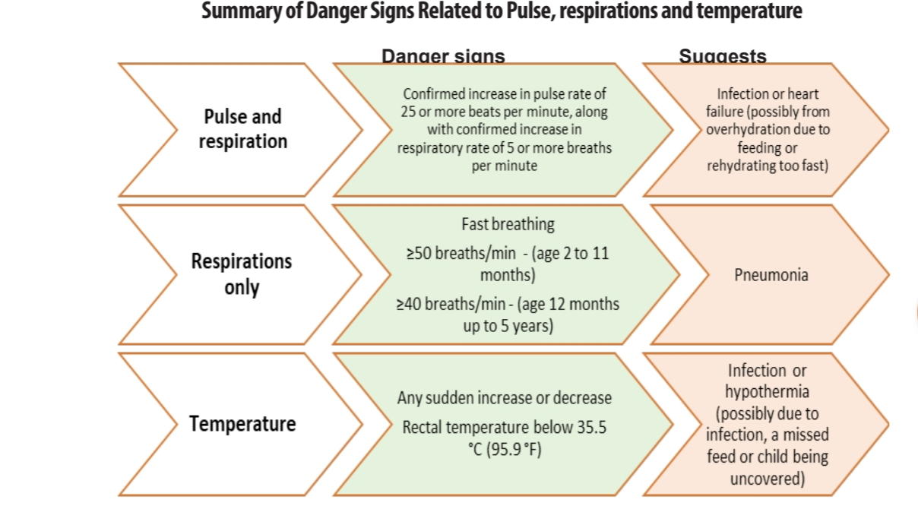
Other danger signs include
.Anorexia (loss of appetite)
• Change in mental state (e.g., becomes lethargic)
• Jaundice (yellowish skin or eyes)
• Cyanosis (tongue/lips turning blue from lack of oxygen)
• Difficult breathing
• Difficulty feeding or waking (drowsy)
• Abdominal distention
• New edema
• Large weight changes
• Increased vomiting
• Petechiae (bruising)
  Monitor RR,PR,T and watch for danger signs

Slide 116
Cont…
Skin care
  If the child has severe (+++) dermatosis, bathe for 10-15 min/day in 0.01% potassium permanganate solution.
  If potassium permanganate solution is not available gentian violet, zinc and castor oil ointment, petroleum jelly, or paraffin gauze dressing can be used.
  If the diaper area becomes colonized with Candida, use nystatin ointment or cream after bathing.
  Leave off diapers (nappies) so the affected area can dry. Be sure to dry the child well after a bath and wrap the child warmly.

Slide 117
Discharge Outcomes
1. Cured:- Has reached the discharge criteria for SAM treatment
2. Died:- Dies while receiving treatment in the SC.
3. Defaulted:- Absent for two consecutive days in the SC
4. Non-responder:- Patient who remained in treatment in the SC does not reach the SAM discharge criteria after 16 weeks (4 months) in treatment.
5. Stabilized;- Condition has stabilized and referred to continue treatment in OTP.
6. Transferred-out :- Moved to another facility for further medical care or moved out to receive care in another SC

Slide 118
Involving Mothers in child care
There are many ways to encourage mothers’ involvement in hospital care.
Mothers can be taught to
• Prepare food
• Feed children
• Bathe and change children and
• Play with children, supervise play sessions, and make toys for emotional and physical stimulation.

Slide 119
OUT-PATIENT THERAPEUTIC PROGRAM
(OTP)

Slide 120
Admission procedure to OTP
  Step 1: Triage
  Step 2: Assess for nutritional status
  Step 3: Clinical assessment
  Step 4: Perform the appetite test with RUTF
  Step 5: Counselling in OTP and use of RUTF
  Step 6: Dispense medication and RUTF
  Step 7: Follow Up in OTP

Slide 121
Criteria for OTP (6 month-59 months)
All children with SAM, which means
Weight for height <-3 sd
MUAC <11.5 cm
Edema (+/++) and:
  Who passed appetite test(If the child eats some of the RUTF within 30 minutes )
  Clinically well
  Alert
  No +++ edema
  Do not have marasmic-kwashiorkor

Slide 122
Appetite test
  Why do we do appetite test?
    No signs of clinical infection in children with SAM
    No perfect correlation between metabolic malnutrition & anthropometric malnutrition
    Metabolic malnutrition is the common cause of death and often its sign is loss of appetite
    Appetite test is the most important criteria to admit SAM either to inpatient or OTP
    Poor appetite means significant infection or metabolic dysfunctions like liver dysfunction, electrolyte imbalance and high risk of death.

Slide 123
OTP entry category
  New admission :New case who meets the admission criteria for OTP
  Readmission.
  Relapse: Cured within the past 3 months and now meets the admission criteria for OTP.
  Returned defaulter: Defaulted within the past 3 months and has returned to OTP
  Transfer-in Continuing treatment in OTP after stabilisation in SC or has moved in from another OTP facility.

Slide 124
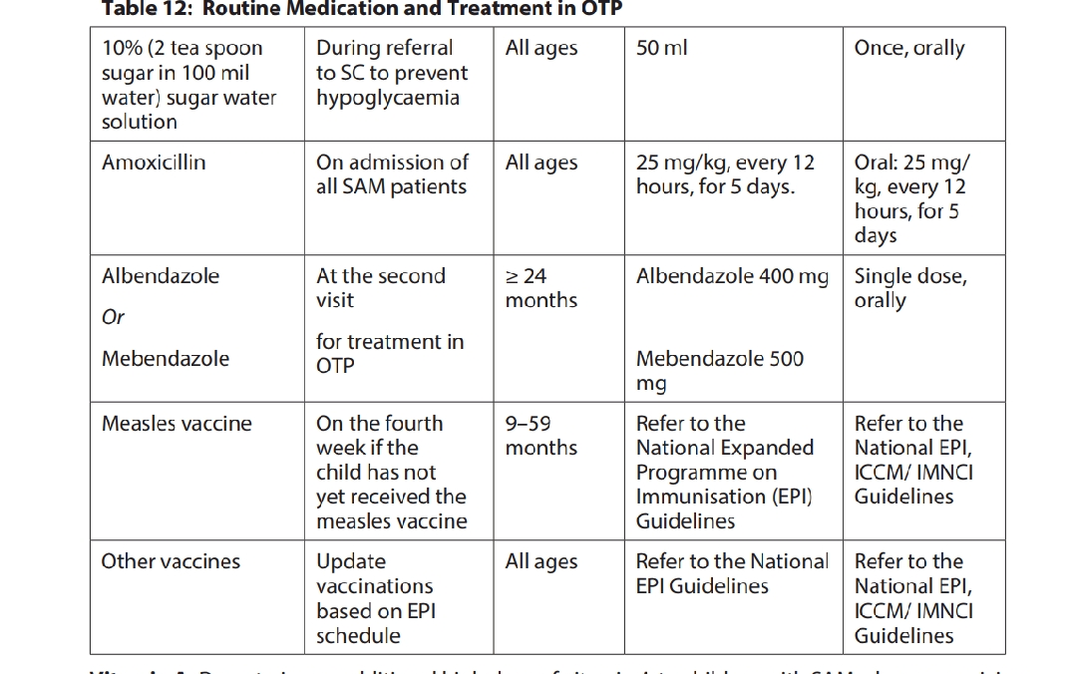

Slide 125
Exit category for OTP
Cured: Has reached the discharge criteria for SAM treatment.
Died: Dies while receiving treatment in the OTP.
Defaulted: Absent for two consecutive visits. Default should be confirmed.
Non-responder: Does not reach the SAM discharge criteria after 16weeks (4 months) in treatment.
Transfer out: Condition has deteriorated or not responding to treatment according to action protocol and referred for treatment in the SC or moved out to receive OTP in another facility.

Slide 126
MANAGEMENT OF MODERATE ACUTE MALNUTRITION
(MAM)
MAM is defined by a MUAC ≥ 11.5 cm and < 12.5 cm or a
WFH ≥ -3 z-score and < -2 z-score (WHO standards) in children 6-59 months old.
PLW with MUAC <23cm.
SFPs aim to prevent and rehabilitate acute malnutrition.
Provide a two-week supply of specialised nutritious foods
Fortified blended food (FBF) e.g., Super Cereal Plus, and RUSF(1 sachet daily ) are the two types of specialised nutritious foods used for management of MAM in Ethiopia.
Follow-up visits conducted every two weeks.
Check and provide routine medications such as vitamin A, deworming, and routine immunizations

Slide 127
Types of SFP
Blanket Supplementary Feeding Programme (BSFP)
  BSFP is implemented when the Global Acute Malnutrition (GAM) levels are high and food insecurity is severe as part of an emergency response or as a response to seasonal shocks
  • The admission and discharge criteria for BSFP does not rely on anthropometric indicators.
  • Define the targeted groups, for example, all children aged 6-23 months or 6-59 months, or all PLW.
  • BSFP normally operates for a period of about 3-6 months, after the situation has stabilized, it is closed and those registered are discharged

Slide 128
Screen the individuals by measuring MUAC and assessing for bilateral pitting oedema. The screening is conducted to identify cases who may require referral for SAM management. It is not used for admission to the BSFP.
Targeted Supplementary Feeding program (TSFP)
Are generally used for treatment of MAM within individuals based on anthropometric admission criteria..
A. Children 6-59 months :-MUAC >11.5 to <12.5 cm OR WFH >-3 to <-2 Z scores AND No bilateral pitting oedema Clinically well and alert
B. PLW :MUAC < 23.0 cm

Slide 129
References
WHO guideline updates on the management of severe acute malnutrition 2013
Guidelines for the Management of Acute Malnutrition Government of Ethiopia Federal ministry of health , April 2019
Nelson text book 21st edition
Modern nutrition in Health and Disease, 10th edition
The 2019 Mini Ethiopia Demographic and Health Survey(EDHS)

Slide 130
GALATOOMAA !

